Slide 1
INTRODUCTION TO ASSEMBLY LANGUAGE
CS 348
Implementation of Programming Languages Lab
Computer Science and Engineering Department
Indian Institute of Technology
Guwahati

Slide 2
Basics

Slide 3
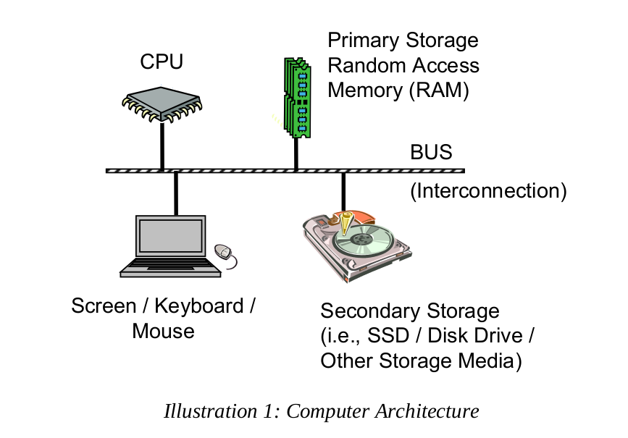
Computer Architecture
Department of Computer Science & Engineering, IIT Guwahati
3

Slide 4
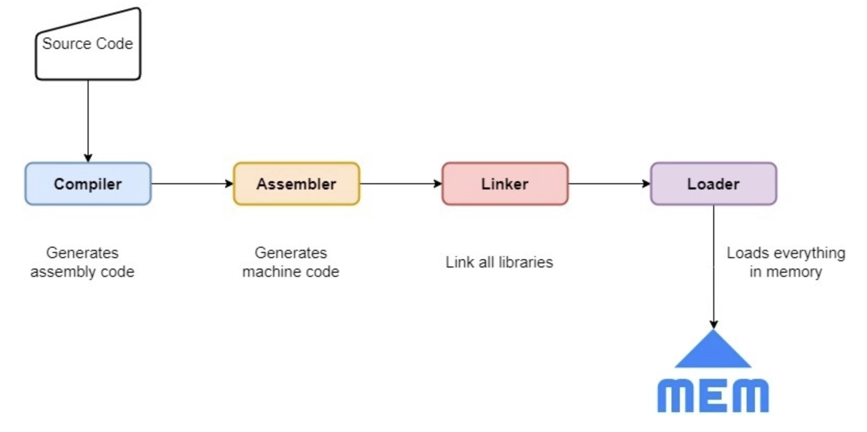
Executable Generation
Department of Computer Science & Engineering, IIT Guwahati
4

Slide 5
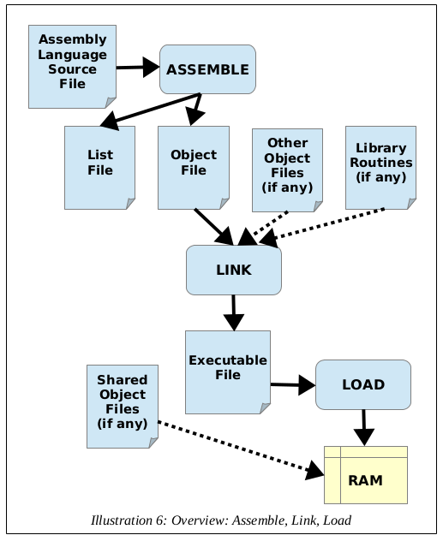
Assemble code steps
$nasm –f elf32 ex1.asm -o ex1.o
Elf32: 32 bit executable linking format.
-f: flag to create elf
$ld –m elf_i386 ex1.o -o ex1
-m: flag to create linker executable from the object file
$./ex1
Execute the final code.
$echo $?
Inspects exit status

Slide 6
High Level language
Program to find if a number is even or odd:
Let, n is the number to be checked.
If (n%2 == 0)
{
Print("Number is even");
}
Else
{
Print("Number is odd");
}
Characteristics:
Portable: Code from one CPU can be used in other CPUs.
Complex: One statement can perform multiple tasks.
Human Readable: Structured and can be easily understood.
Department of Computer Science & Engineering, IIT Guwahati
6

Slide 7
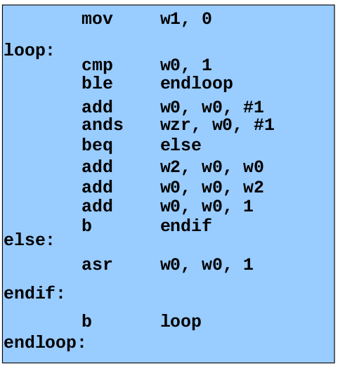
Assembly Language
Characteristics:
Not Portable: Each assembly language instruction maps to one machine language instruction.
Simple: Each instruction does a simple task.
Human Readable: Structured but not as easily understood as HLL.
Department of Computer Science & Engineering, IIT Guwahati
7

Slide 8
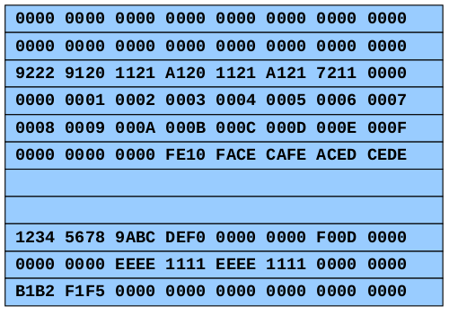
Machine Language
Characteristics:
Not Portable: Processor specific code.
Simple: Each instruction does a simple task.
Not Human Readable: Not Structured and requires lot of effort.
Department of Computer Science & Engineering, IIT Guwahati
8

Slide 9
Why learn assembly language?
It is used for direct hardware manipulation.
It helps us access specialized processor instructions.
It helps us address critical performance issues.
Many real time systems, low level embedded systems and device drivers use Assembly Language.
We learn how the OS interacts with input/output, system calls such as interrupt.
It helps us improves algorithm development skills.
It helps us improve the understanding of functions/procedures.
It helps us gain an understanding of I/O buffering.
It helps us adapt to changes in the computing world.
Department of Computer Science & Engineering, IIT Guwahati
9

Slide 10
X86 Architecture

Slide 11
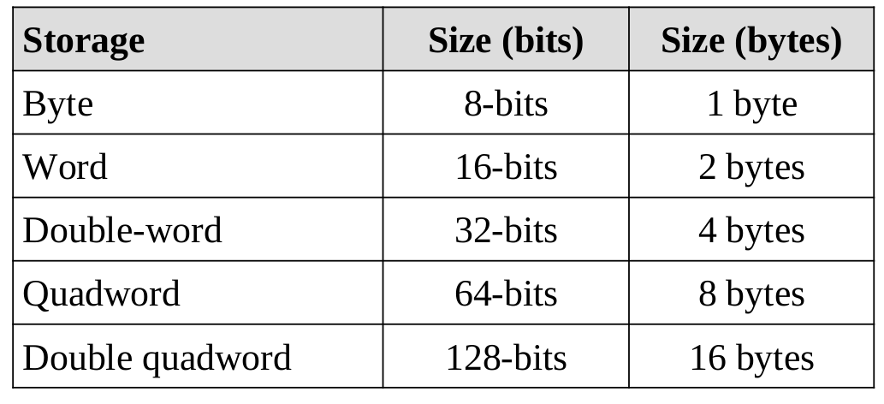
Data Storage Sizes
The x86 architecture supports a specific set of data storage size elements.
The sizes are based on powers of 2.
These storage sizes have a direct corelation to variable declarations in HLL (e.g., C, C++, Java, etc).
Department of Computer Science & Engineering, IIT Guwahati
11

Slide 12
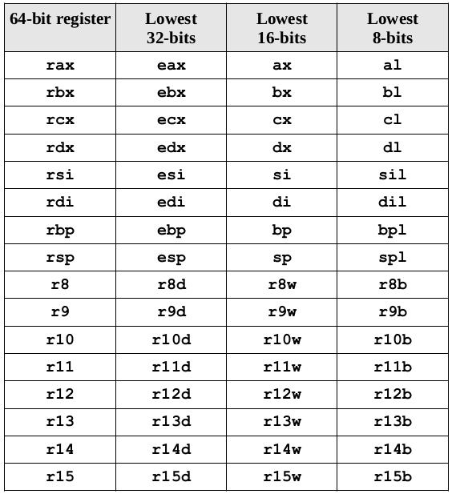
CPU Registers
A CPU register is a temporary storage built into the CPU itself.
Computations are typically performed on them.
The types of such registers are:
General Purpose Registers (GPRs)
Stack Pointer Register (RSP)
Base Pointer Register (RBP)
Instruction Pointer Register (RIP)
Flag Registers (rFlags)
XMM Registers
Department of Computer Science & Engineering, IIT Guwahati
12

Slide 13
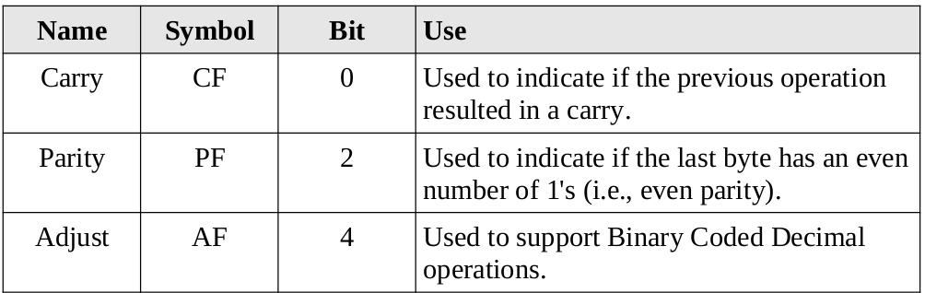
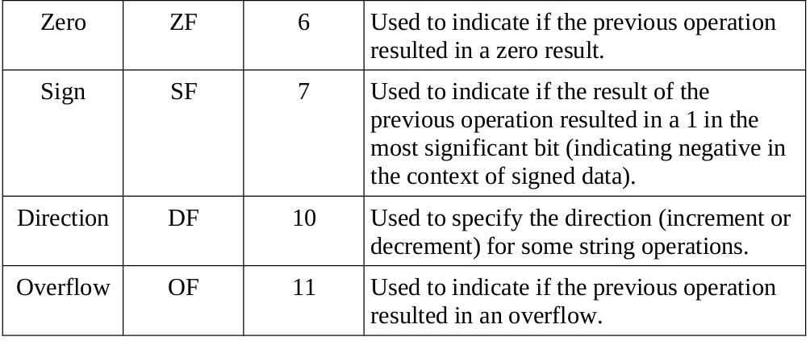
Flags
Department of Computer Science & Engineering, IIT Guwahati
13

Slide 14
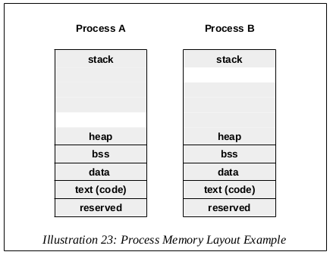
Process Stack
The rsp is used to point to the current top of stack in memory.
The stack is implemented growing down in the memory.
The heap grows upwards, while the stack grows downward, to ensure most effective use of memory.
If the stack and heap meet, the program will crash.
Department of Computer Science & Engineering, IIT Guwahati
14

Slide 15
Program Format

Slide 16
Program Format
A properly formatted assembly source file consists of several main parts:
Data section: Initialized data is declared and defined.
BSS section: Where uninitialized data is declared.
Text section: Where code is placed.
Comments can be placed after semicolon (;). Any instruction after ; are ignored by the compiler for that line.
Numerical values may be specified in decimal, hex or octal.
'0x' preceeds hex values
'q' preceeds octal values
Decimal doesnt require any notation.
Department of Computer Science & Engineering, IIT Guwahati
16

Slide 17

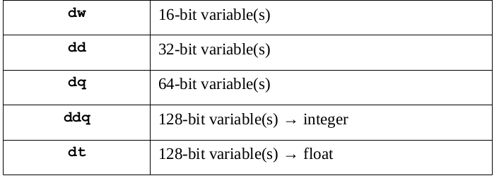
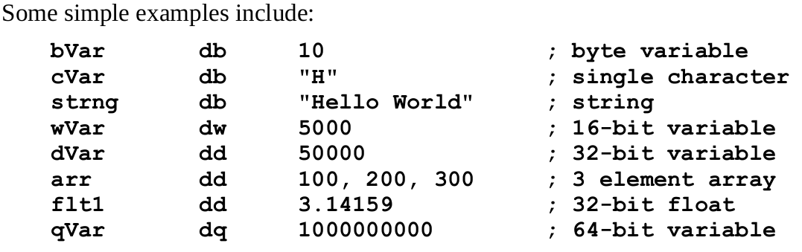
Data Section
Supported Data Types
The initialized data must be declared in the "section .data" section.
Variable name must start with a letter, followed by letters or numbers, and some special characters.
The general format is:
<variable name> <dataType> <initialValue>
Department of Computer Science & Engineering, IIT Guwahati
17

Slide 18
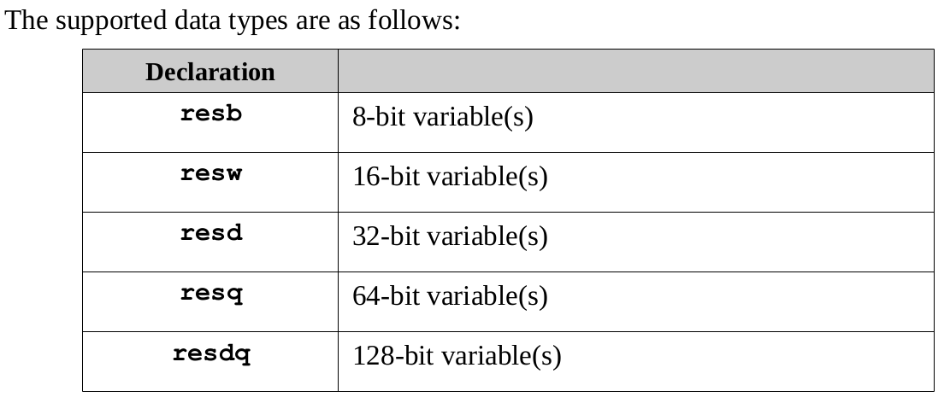
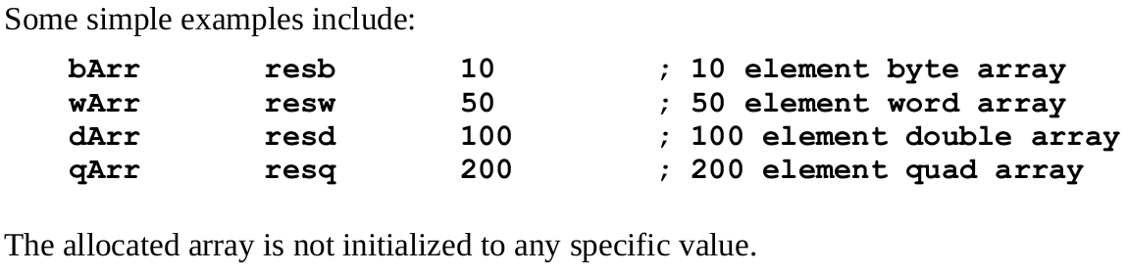
BSS Section
The uninitialized data is declared in the "section .bss" section.
Variable name must start with a letter, followed by letters or numbers, and some special characters.
The general format is:
<variable name> <resType> <count>
Department of Computer Science & Engineering, IIT Guwahati
18

Slide 19

Text Section
The code is placed in the "section .text" section.
The instructions are specified one per line.
Each instruction must be valid with appropriate operands.
It includes some headers or labels that define initial program entry.
Assuming a basic program using the standard system linked, the following declarations must be included.
No special label is required to terminate the program.
The OS should be informed so that resources can be recovered and re-utilized.
Department of Computer Science & Engineering, IIT Guwahati
19

Slide 20
Text Section key terms
Global- It is the keyword used to make identifier accessible to linker.
_start- The processor starts compiling from this. It is equivalent to main() in C.
Label: -Any word with a colon in the text section is a label. It can be accessed via jumps.
Int 0x__ – It is an interrupt specified by the hex code following it.
0x80 – hex code used to call system calls based on the value in the 'eax' register.
Department of Computer Science & Engineering, IIT Guwahati
20

Slide 21
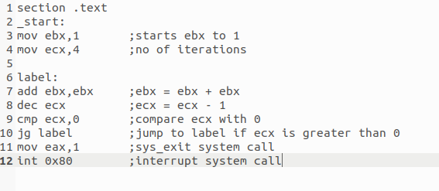
Program Example
A program to calculate 2^{x}
The output of the program is 16.
Department of Computer Science & Engineering, IIT Guwahati
21

